Slide 1
Lecture 4
NLP&Visualization
Provilkov Ivan
iv.provilkov@gmail.com

Slide 2
Plan
Projects presentations
Overview of tasks and open problems in NLP
iPavlov, not only dialog system

Slide 3

Dependency Parsing
Dependency structure shows relations between words in sentences.
Structure usually is the tree - undirected graph in which any two vertices are connected by exactly one path

Slide 4
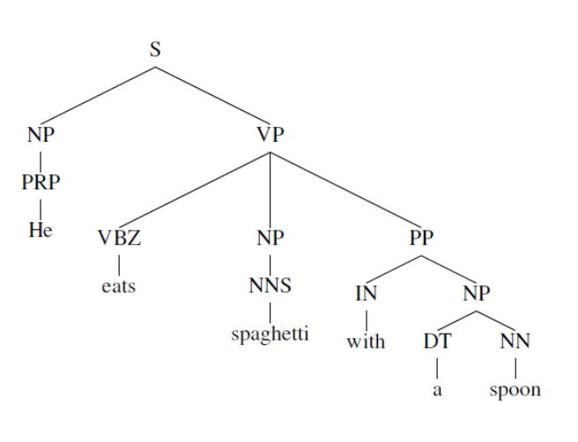
Dependency Parsing

Slide 5
Dependency Parsing
There are different ways to define rules, and they will have different profit.
Best parsing methods are neural now.
Question: Why do we need dependency parsing?

Slide 6
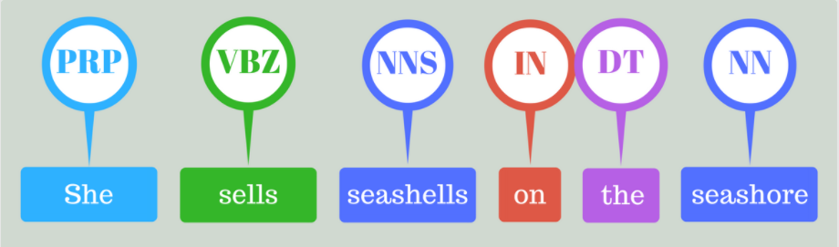
Tagging
Example: Part Of Speech (POS) tagging.

Slide 7
Tagging
Having appropriate dataset you can tag everything that you want, for example different name entities.
Now taggers are usually neural
Slightly later you will understand why we are talking about this.

Slide 8
Discussion about problems
Deep neural networks allow us to solve many problems really great, you can use things like BiLSTM with Attention in a lot of tasks
But there are still some problems and open questions

Slide 9
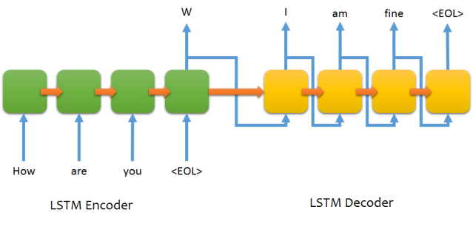
Some words about attention
Question: Where is the problem?

Slide 10
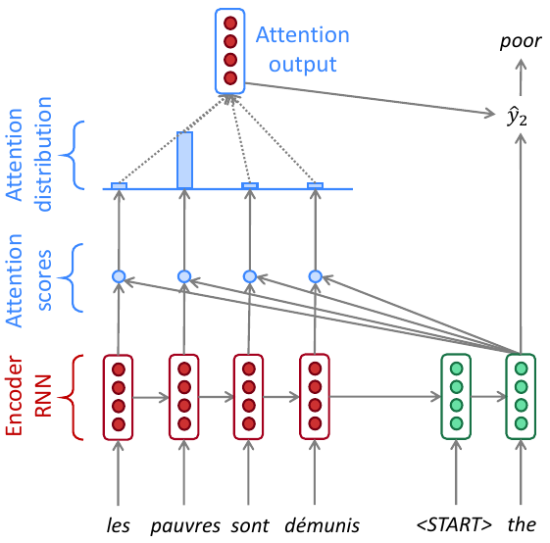
Some words about attention
Attention provides a solution to the bottleneck problem

Slide 11
Some words about attention
Having encoder hidden states we multiply them by current decoder hidden states.
We use softmax to get probabilities (scores).
We sum encoder hidden states with softmax score to get attention output.
Finally we concatenate attention output with decoder hidden state and proceed them to the decoder to generate next token.

Slide 12
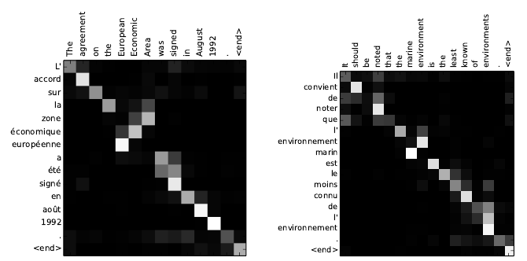
Also, now you are able to draw such pretty pictures. (Attention)
Neural machine translation by jointly learning to align and translate, Bahdanau et al.

Slide 13
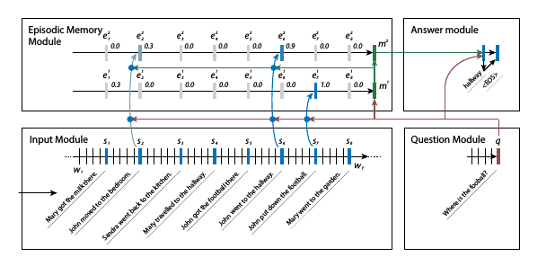
Returning to the problems:
Memory access

Slide 14
Understanding
Neural networks still do not know anything about goals and intentions.
Translation systems do not see relations between sentences in bit texts
Many systems start working bad if you change scope of work, even slightly.
Also, it is difficult to say what do you want via sentence to machine.

Slide 15
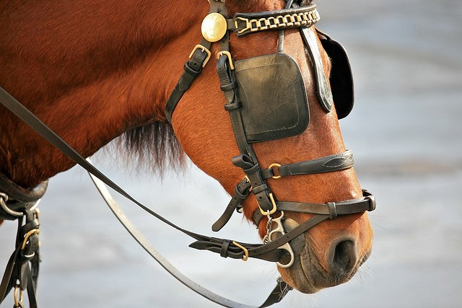
Single task learning
There is no general architecture for any task.
Every model is specified, so we have not got general NLP approach. Consequently, we do not reach best possible quality.

Slide 16
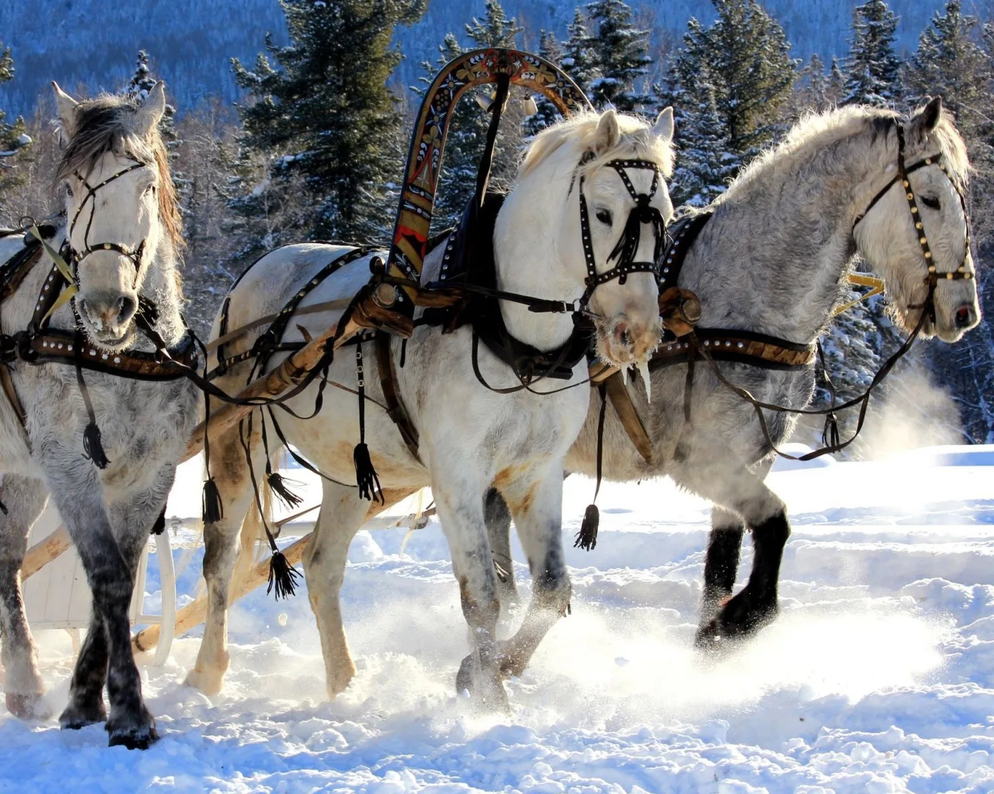
Possible solution: Multi-task learning
We can use one model to do several things at the same time.
For example, you can make RNN model with many heads, each for different task: tagging, translation, language model...

Slide 17
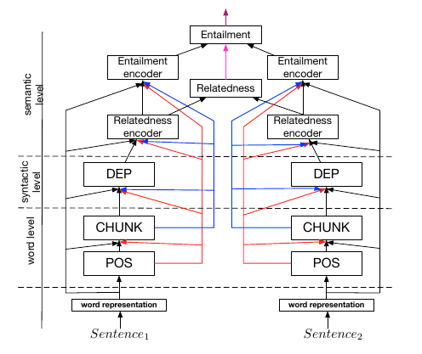
Multi-task learning
And it works.
This method helps to improve score
in different tasks in comparison with single-task models.
A Joint Many-Task Model: Growing a Neural Network for Multiple NLP Tasks, Hashimoto et al.

Slide 18
Non text data
In some tasks we need to take or produce information without words at all.
For example, images or databases.

Slide 19
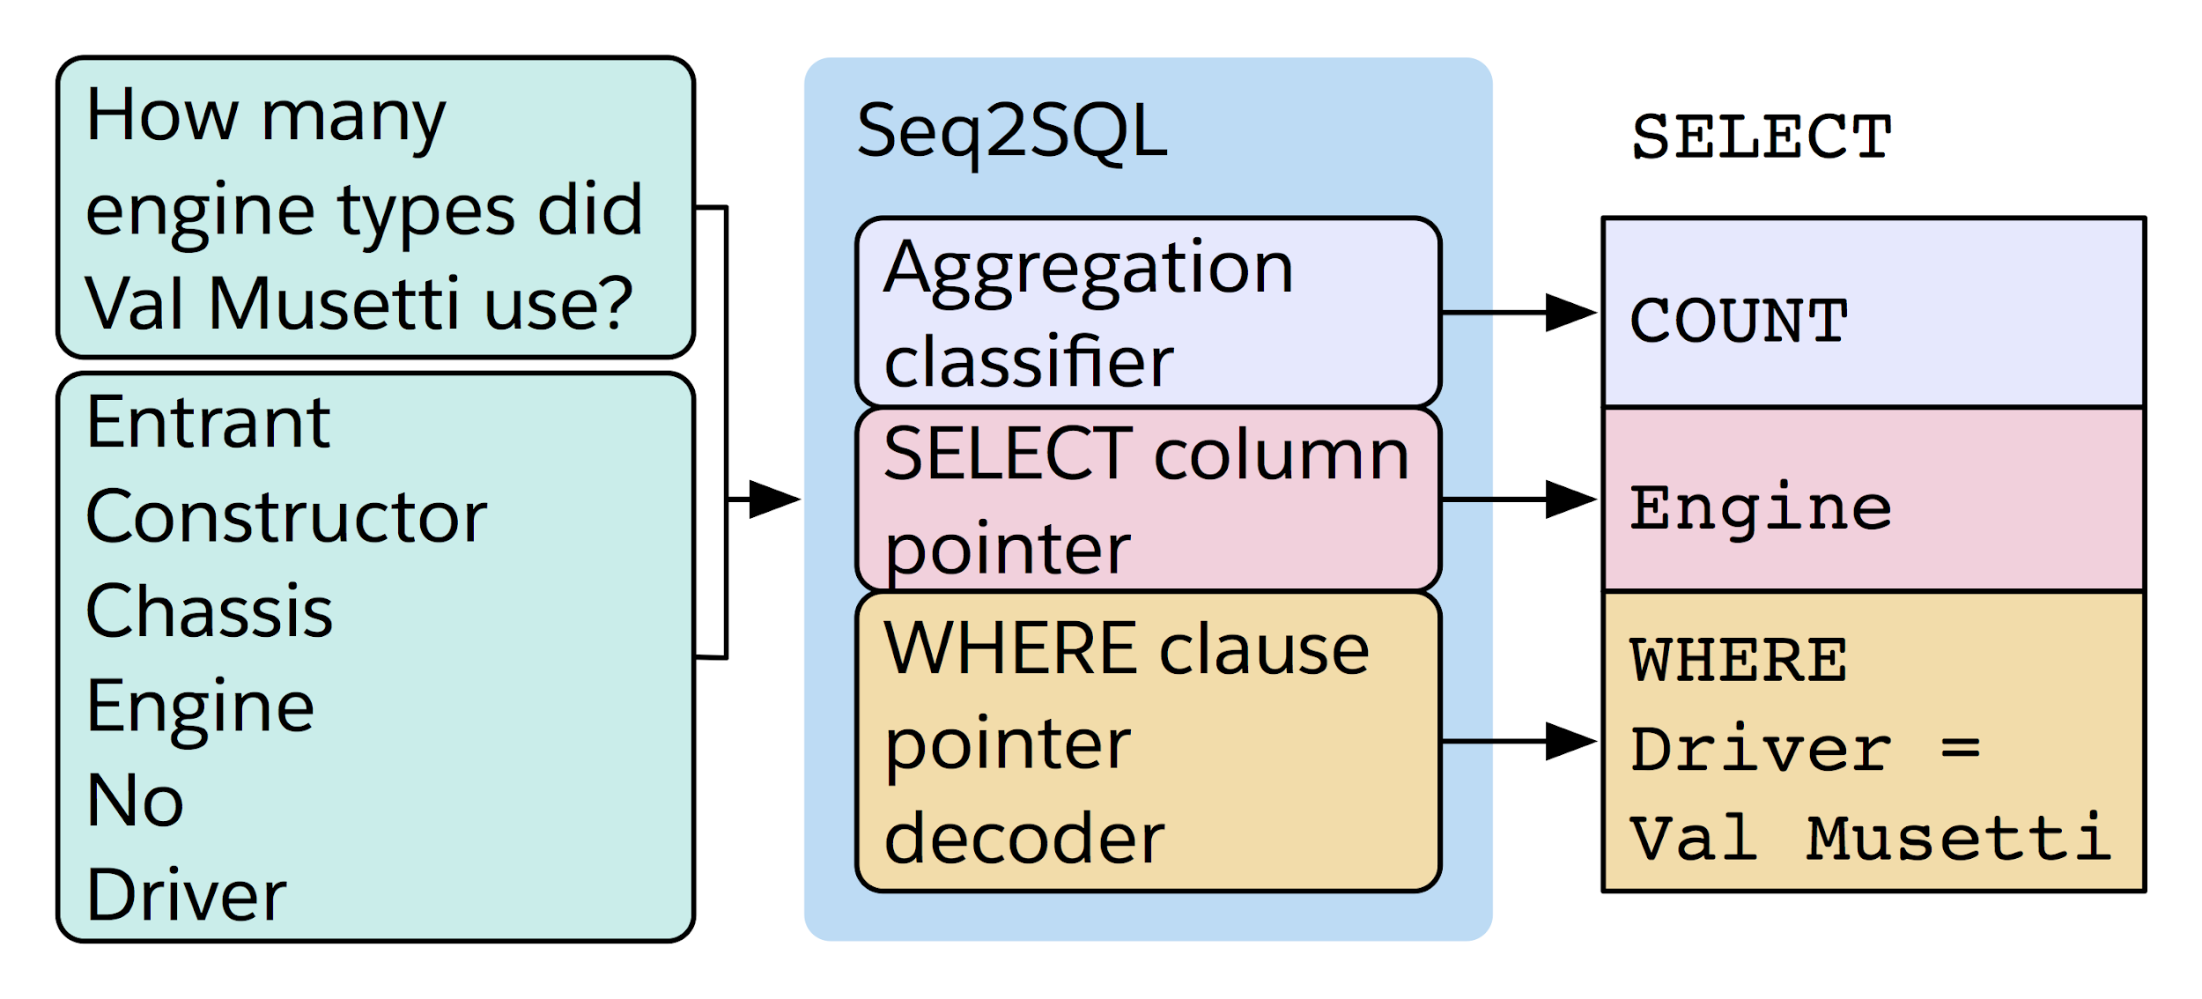
Databases
Seq2SQL: Generating Structured Queries from Natural Language using Reinforcement Learning, Zhong et al.

Slide 20
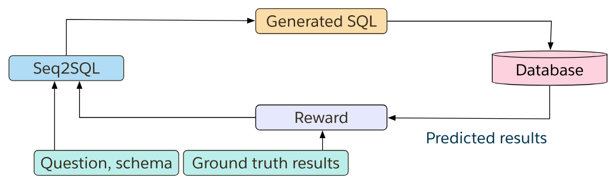
Databases

Slide 21
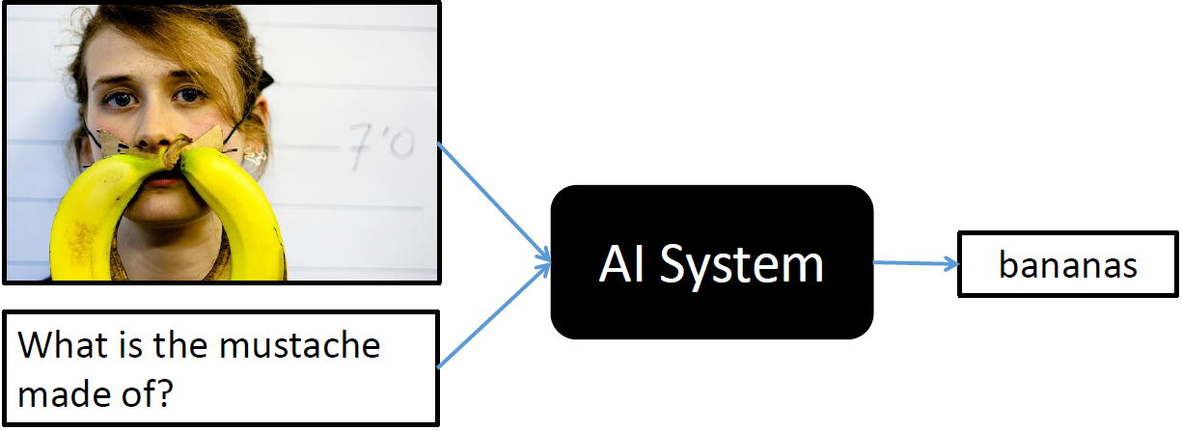
Images, visual QA
VQA: Visual Question Answering, Agrawal et al.

Slide 22
Remnant
Comprehensive Question Answering
Fast learning
Few examples learning

Slide 23
iPavlov
https://ipavlov.ai/
Mostly known for working with their dialog system.
But they also provide some useful features.

Slide 24
iPavlov
Named entity recognition, they provide pretrained baseline for events, persons, goods and so on. Also they have a cold start model, that you can use for further improvements.
Text classification. There are CNN, BiLSTM, BiLSTM + CNN, BiLSTM+Attention models pretrained for different tasks
...

Slide 25
iPavlov
Sentence similarity ranking, Siames NN learned to predict appropriate answer knowing context. It is good for semantic ranking.
Morphological tagger CharCNN + BiLSTM. Also, you can train it on any dataset for tagging.
TFIDF document ranker. Analogically, pretrained.
…

Slide 26
iPavlov
Open domain Question Answering
ELMO embeddings
Fasttext embeddings
…
And all this stuff is available for both Russian and English languages!

Slide 27
Thank you for your attention.

